Slide 1



Welcome Home
The Global Center for
Spiritual Awakening
Community

Slide 2
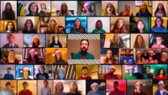
Shared with permission, YouTube https://youtu.be/UTpqrF95pcE

Slide 3

Don’t Save It All for Christmas Day
Shared with permission,
YouTube https://youtu.be/-O2ZfcYbfQc?si=IdJlxkNpNLXonqlp

Slide 4

The Gift of
Spirituality

Slide 5


Slide 6
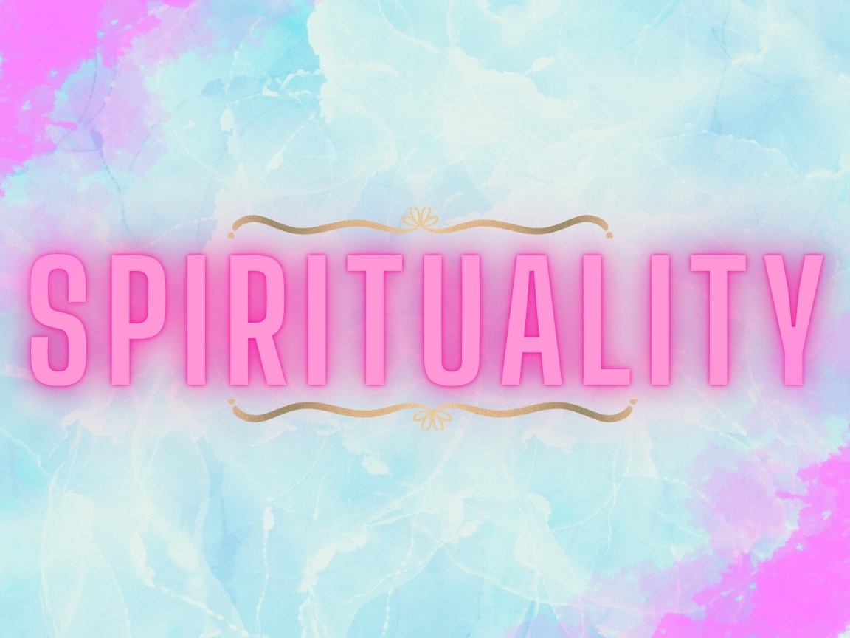

Slide 7
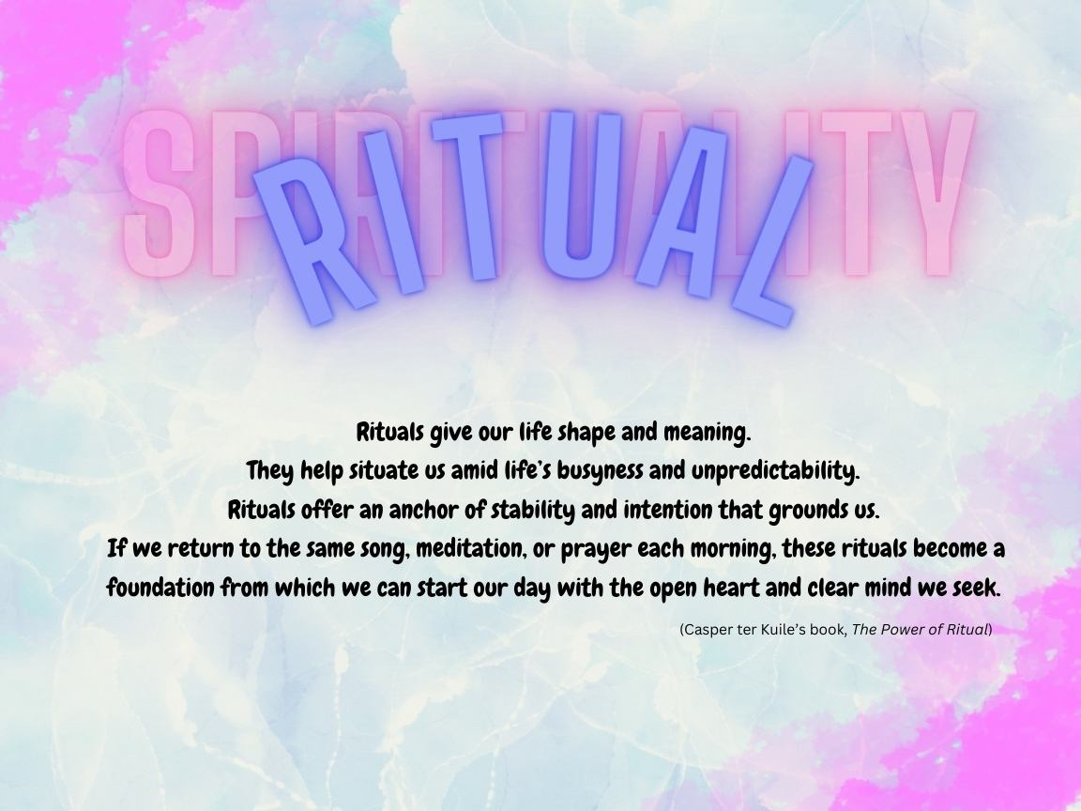

Slide 8
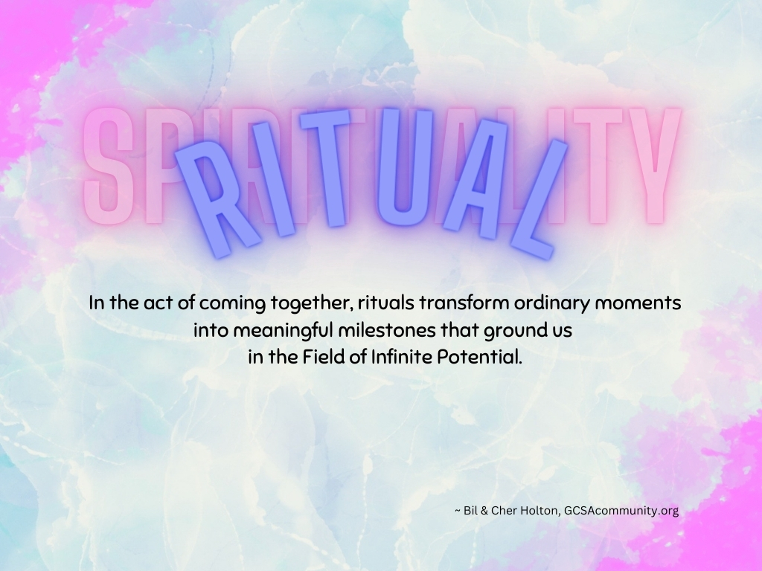

Slide 9
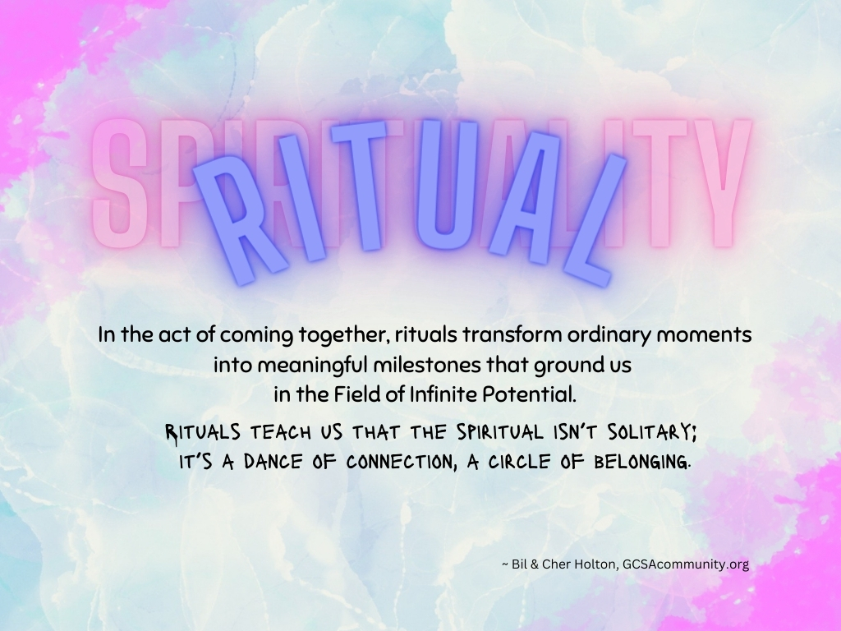

Slide 10
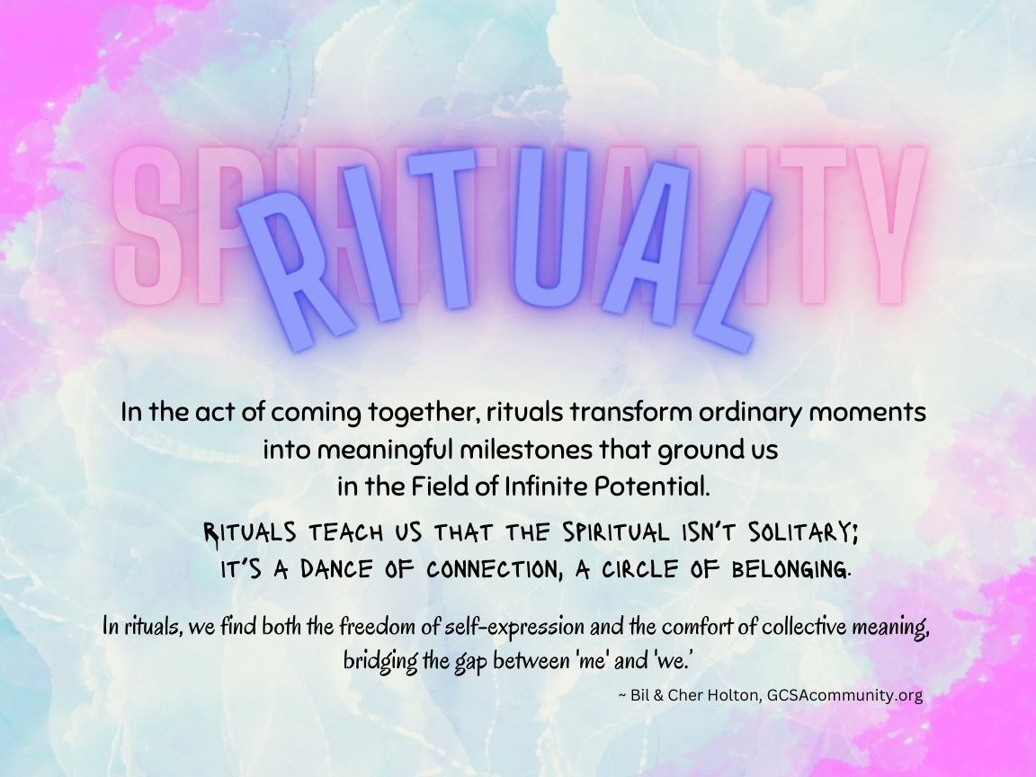

Slide 11



Slide 12


Slide 13
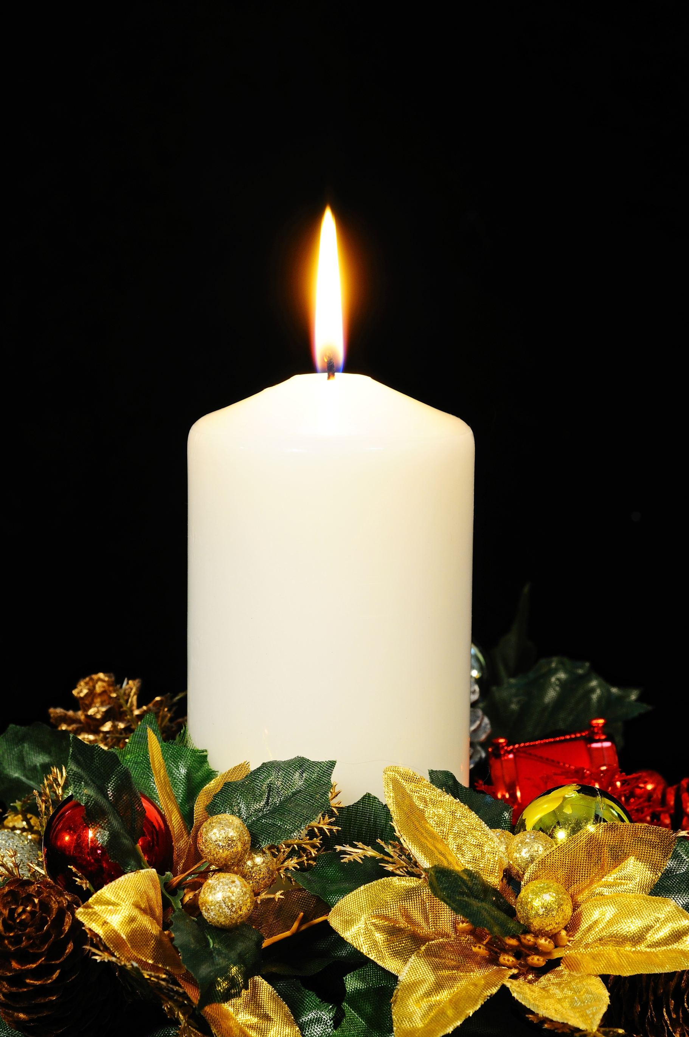

Slide 14

Authentegrity
I claim my Authentegrity now. Today, I refuse to allow doubt or fear to have a space in my consciousness. I stand firmly in my Authentegrity, keeping my priorities in line with my spiritual beliefs and values. I have the confidence to stand in my Truth, and “be the True Me” in everything I do. I claim my Authentegrity to express my Extraordinary Nature now!

Slide 15

Intuitive Wisdom
I claim my Intuitive Wisdom now. Today, I make time to go into the Silence and call on my highest levels of perception and understanding. “I know that I know that I know”—and am tuned into the frequency of the Infinite. With this Intuitive Wisdom I can master the art of living in skin school. I claim my Intuitive Wisdom to express my Extraordinary Nature now!

Slide 16

Inner Strength
I claim my Inner Strength now. Today, I will consistently honor my Inner Strength and I will not give up or give in! I stand strong in my Inner Strength to accomplish what is mine to do with patience, poise, and practicality. I am resilient. I am strong. I claim my Inner Strength to express my Extraordinary Nature now!

Slide 17

Optimistic Spirit
I claim my Optimistic Spirit now. Today, I honor my incurable optimism and positive outlook on life. I think positive thoughts, make optimistic choices, and take life-affirming actions. I know with confidence that I can Divinely Order every experience and use my innate Core Abilities and Spiritual Principles to work all things together for good! I claim my Optimistic Spirit to express my Extraordinary Nature now!

Slide 18

Questioning
Unquestioned
Answers
I claim my ability to Question Unquestioned Answers now. Today, I remain curious and open to incredible opportunities to enter the realm of enlightened thought. I make it a habit of always questioning what is already known—always seeking the highest Truth. I claim Questioning Unquestioned Answers to express my Extraordinary Nature now!

Slide 19

Self Reliance
I claim my Self Reliance now. Today, I honor my Inner Lotus of Control by trusting in my talents, skills, education, intuition, experience, and instincts. I control my destiny by ensuring my Human Nature is aligned with my Extraordinary Nature. I have control over my response to all the events in my life—and I choose to use all things for good. I claim my Self Reliance to express my Extraordinary Nature now!

Slide 20

Giving
Consciousness
I claim my Giving Consciousness now. Today, I honor my Giving Consciousness by rejoicing in every opportunity for giving, with no attachment to an outcome and no expectation of return. I offer all my gifts generously to support people and organizations, to cultivate good will, to help make other people happier, and to bring the joy of generosity to the world. I claim my Giving Consciousness to express my Extraordinary Nature now!

Slide 22
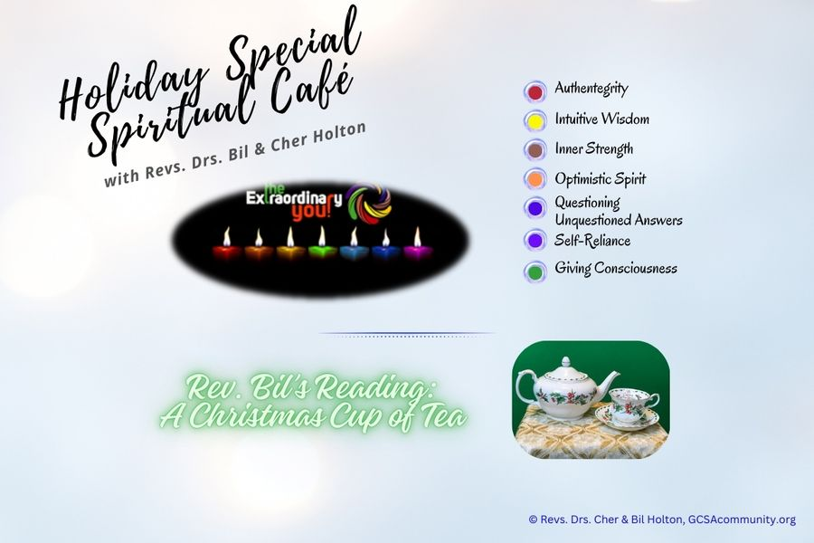

Slide 23
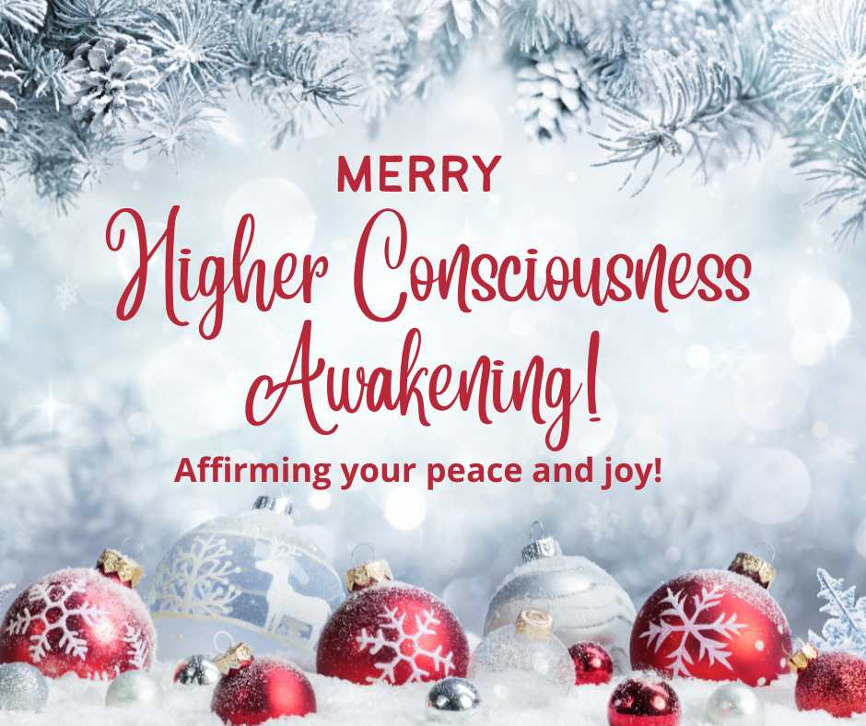

Slide 25

Authentegrity
Intuitive Wisdom
Inner Strength
Optimistic Spirit
Questioning
Unquestioned
Answers
Self Reliance
Giving Consciousness

